Slide 1

Introduction to Blazor
Kaushik Roy Chowdhury

Slide 2
Introduction to Blazor
Blazor is a framework for building interactive client-side web UI with .NET
The characteristics of Blazor FW are as follows:
Create rich interactive UI’s using C# (instead of JavaScript)
Share server-side and client-side app logic written in .NET
Render the UI as HTML and CSS for wide browser support (including mobile browsers)

Slide 3
Introduction to Blazor
Using .NET for client-side web development offers the following advantages:
Write code in C# instead of JavaScript
Leverage the existing .NET ecosystem of libraries
Share app logic across server and client
Stay productive with Visual Studio on Windows, Linux and macOS
Build on a common set of languages, frameworks, and tools that are feature rich and easy to use

Slide 4
Components
Blazor apps are based on components
A component in Blazor is an UI element, such as a page, dialog or data entry form
Components are .NET classes built into .NET assemblies that
Define flexible UI rendering logic
Handle user events
Can be nested and reused
Can be shared and distributed as Razor class libraries (or nuget packages)

Slide 5
Components
The component class is usually written as a Razor markup page with a .razor file extension.
Components in Blazor are referred as Razor components
Razor is a syntax for combining HTML markup with C# designed for developer productivity
Razor allows us to switch between HTML and C# within the same file with Intellisense support
Though Razor pages and MVC also use Razor, Blazor components are used specifically for client-side UI logic whereas the former are built around a request/response model

Slide 6
Components
The following Razor markup demonstrates a component(Dialog.razor) which can be nested within another component:
<div>
<h1>@Title</h1>
@ChildContent
<button @onclick="OnYes">Yes!</button>
</div>
@code {
[Parameter]
public string Title { get; set; }
[Parameter]
public RenderFragment ChildContent { get; set; }
private void OnYes()
{
Console.WriteLine("Write to the console in C#! 'Yes' button was selected.");
}
}

Slide 7
Components
The dialog’s body content (ChildContent) and title (Title) are provided by the component that uses this component (Dialog) in its UI. OnYes is a C# method triggered by the button’s onclick event
Blazor uses natural HTML tags for UI composition. HTML elements specify components, and a tag’s attributes pass values to a component’s properties.
In the following example, the Index component uses the Dialog component.
@page "/"
<h1>Hello, world!</h1>
Welcome to your new app.
<Dialog Title="Blazor">
Do you want to <i>learn more</i> about Blazor?
</Dialog>

Slide 8
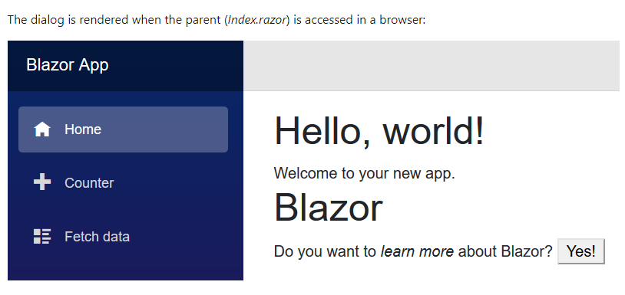
Components
When this component is used in the app, IntelliSense in Visual Studio and Visual Studio Code speeds development with syntax and parameter completion.
Components render into an in-memory representation of the browser's Document Object Model (DOM) called a render tree, which is used to update the UI in a flexible and efficient way.

Slide 9
Get Started with ASP.NET Core Blazor
Get Started with Blazor
Install the latest .NET Core 3 SDK release
Install the Blazor templates by running the following command in a command window :
dotnet new -i Microsoft.AspNetCore.Blazor.Templates::3.0.0-preview9.19465.2
Make sure you’ve installed the latest Visual Studio with the ASP.NET and web development workload
( I have installed the Visual Studio 2019 Community Edition and updated it to version 16.3 that has the required SDK already installed)

